Slide 1


Tigran Gevorgyan
Armbrok: Chief Investment Officer
Investment Ideas:
Other Emerging Markets
X Cbonds Fixed Income Conference
November 9, 2023
Dubai

Slide 2

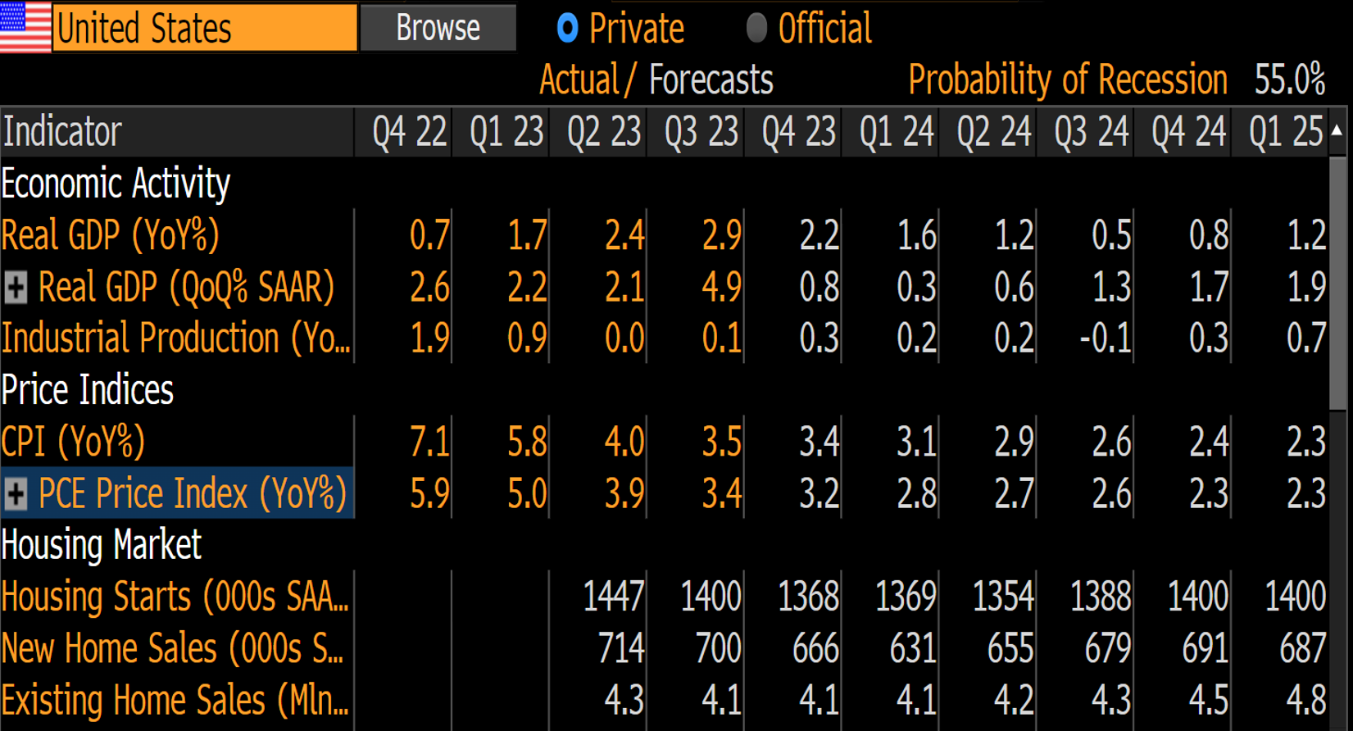
Economic Forecast of US
The market expects “soft landing” with decreasing inflation and no recession.

Slide 3
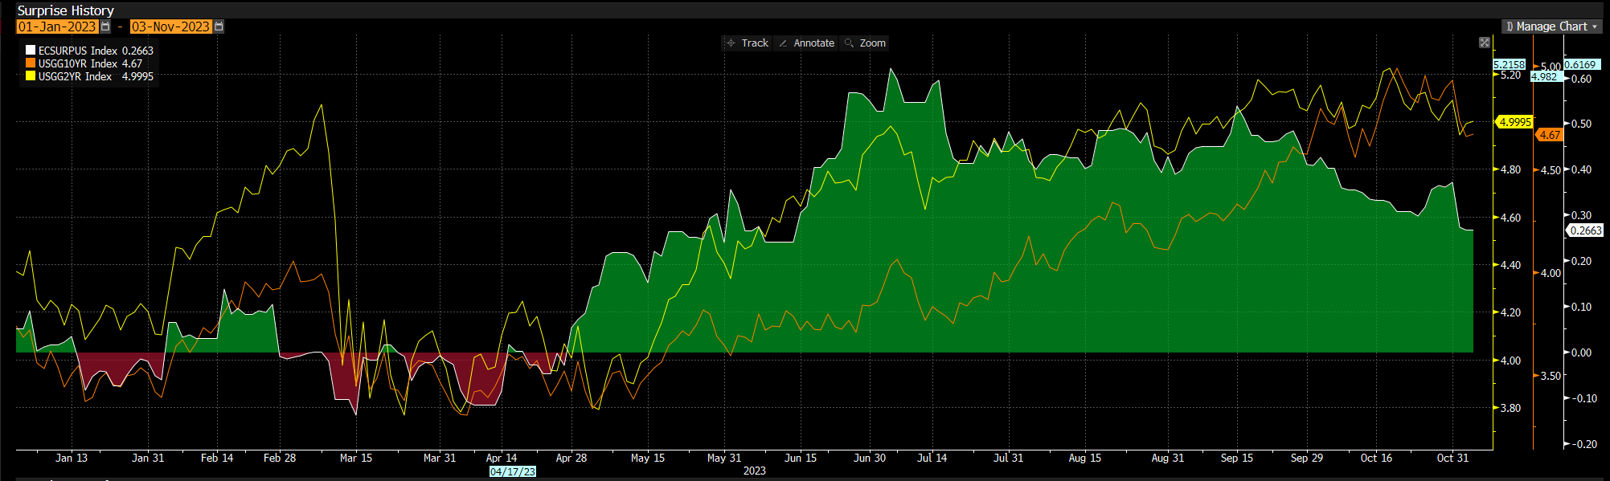
Economic Surprise History of US, YTD
Financial system turbulence at the beginning of the year, dramatically decreased yields and created negative reversion of economic expectations.
But the real data was much better than the market expectations. It created "room" for FED to continue tightening in its monetary policy. It increased yields to pre-financial turbulence levels.

Slide 4
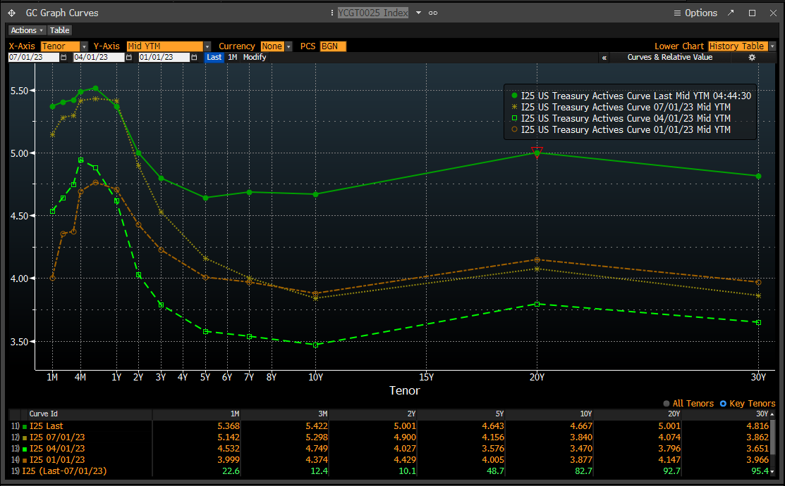
US Treasury Active Curve
Long term rates were much more volatile than short term rates. It created an opportunity for earning additional bond risk premium in long term bonds.

Slide 5
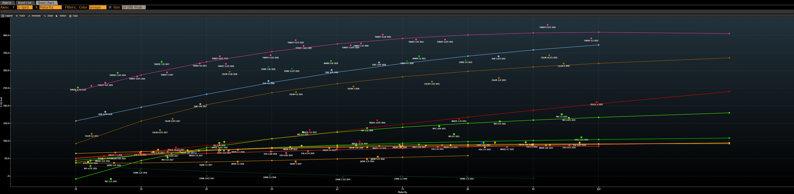
Sovereign bonds of Emerging Markets
Beside the fact that Turkey's sovereign curve is the cheapest, we prefer not to invest in it due to economic and political uncertainty. Rather to buy IG bonds in China.

Slide 6
Median G-spread of corporate bonds
Long term corporate bonds give extra premium in spread terms.
Moreover, long term part of government bonds is oversold in terms of bond risk premium.
*Rounded to the closest 25 basis points

Slide 7
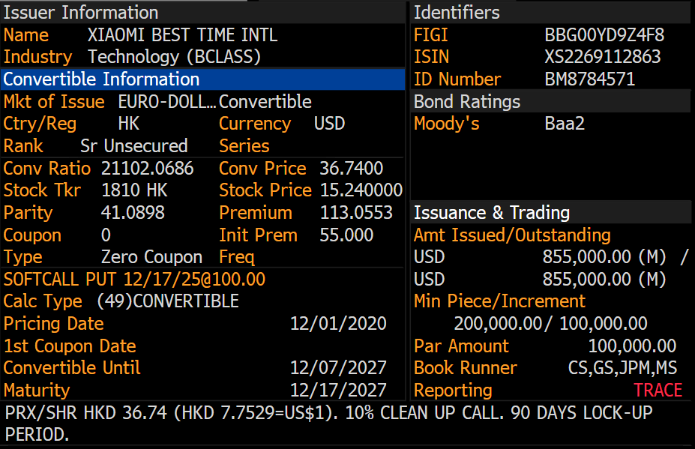
Xiaomi convertible
Convertible bonds, which are pari-passu with senior debt can earn not only yield to maturity, but in case of "soft landing" and global macroeconomic recovery can create opportunities for much more upside.

Slide 8
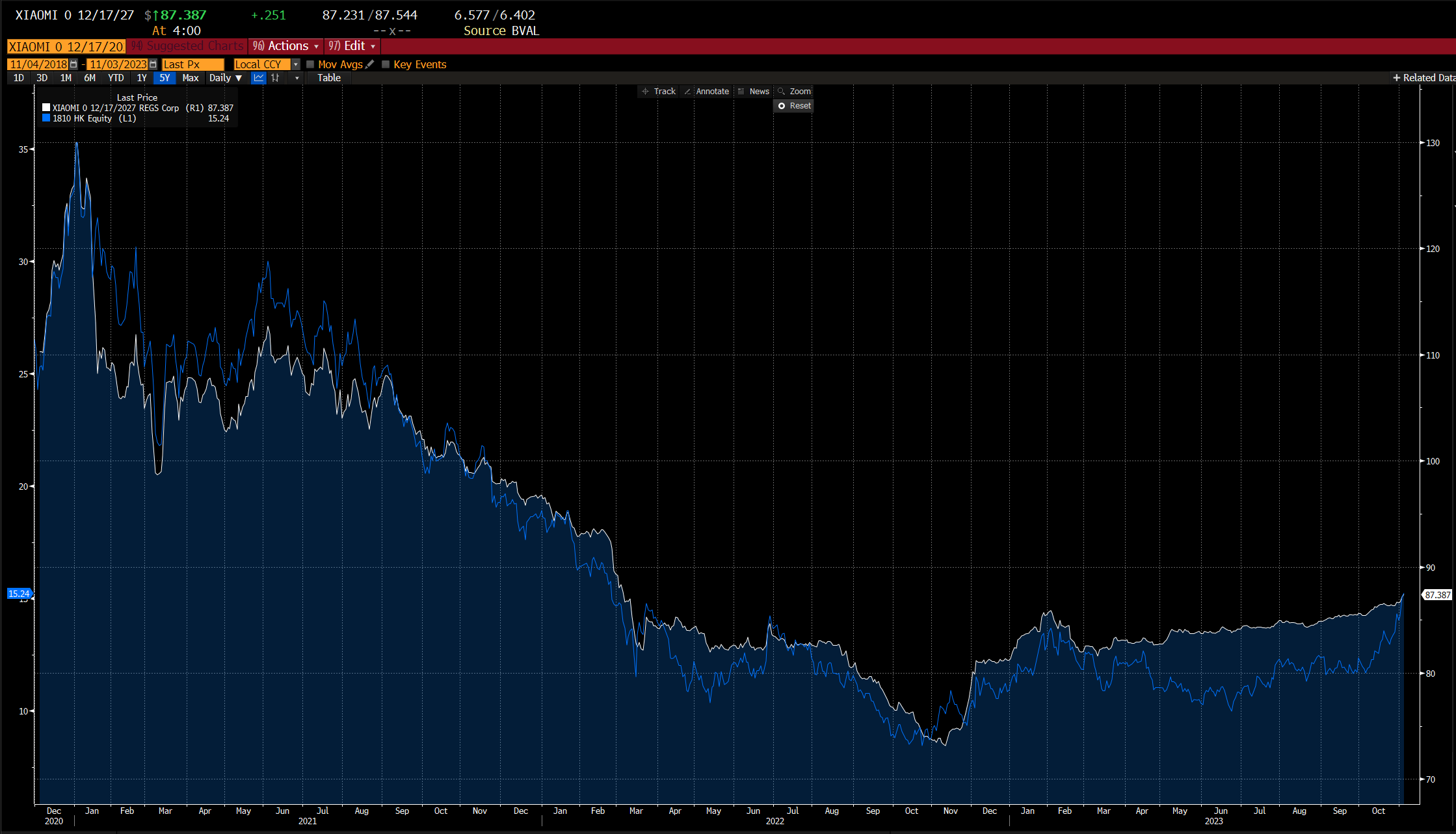
Prices of convertibles and stocks
In case of Chinese stock market will show recovery, in line with global recovery, investor can earn more than 20% of annual return. In worst case scenario investor will earn more than 6% of annual return up to December 2025.

Slide 9
Thank you
39 Hanrapetutyan street 0010 Yerevan, Armenia +37411 590 000 armbrok@armbrok.am www.armbrok.am

